Slide 1

Built in Self Technique (BIST) for Diagnosis of Delay Faults in Cluster-Based FPGAs (Field Programmable Gate Arrays)
Project Work – Phase I (EC - 404)
Department of Electronics and Communication Engineering
National Institute of Technology Nagaland
Under the Guidance of
Dr. Madhusudan Singh
Assistant Professor
Electronics and Communication Engineering
NIT Nagaland
Presented by: Group No. 1
Pradum Kumar Gupta (2023104338)
Prince Raj (2023104339)

Slide 2
Content
Problem Statement & Motivation
Existing Work / Literature Survey
Research / Engineering Gap
Project Objectives
Objective–Methodology–Work Plan Mapping
Proposed Methodology / System Architecture
Work Completed Till Date
Weekly Progress & Individual Contribution
Next Milestones up to Assessment-II
References

Slide 3
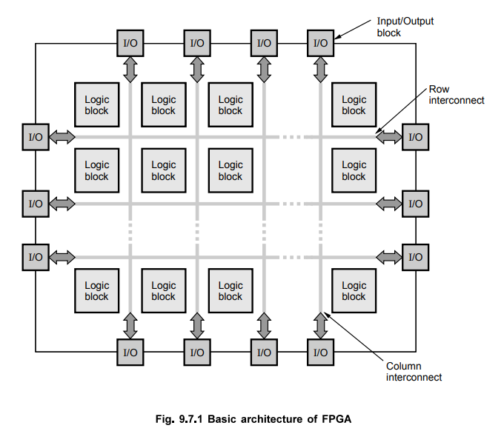
Problem Statement & Motivation
What is the exact problem?
DELAY FAULT
A defect where logic function correctly at low speeds, but signal propagation time exceeds the operational clock period causing setup time violations.
SPEED OF FPGA
The internal clock speed of FPGA is very high (approx. 300 MHz to over 1 GHz), so testing the FPGA at that high speed is not possible with the help of External Automatic Test Equipment (ATE) because it operates much slower than the FPGA’s internal clock speeds.
WHY IT MATTERS
• Substitute of the expensive Testers.
• Acts as an internal, automated doctor for a chip, allowing it to test its own hardware at full operational speed.
• You can modify the testing logic according to your needs.

Slide 4
Existing Work / Literature Survey
Reference studied in the weekly work: Das et al., IET Computers & Digital Techniques (2013) [1]
Ref.
Method / Component
Major outcome studied
Implementation note
[1]
LUT testing
Isolates internal propagation delay from interconnect wire delay using chained LUT configurations and D-Flip Flop register bounding.
Needs too many reconfigurations; leaves unselected internal paths and pin asymmetries untested.
[1]
Multiplexer testing
Tests input and select paths with controlled transitions and divides the MUX to locate the faulty part.
Hold select lines stable while toggling data inputs (and vice-versa) to prevent race conditions and transient glitches
[1]
Arithmetic logic
Characterizes propagation delays along dedication fast carry paths (Cout) and sum generation logic using dual- pattern at- speed vectors (V1- V2)
Force adjacent carry inputs to non-controlling states so transition wavefronts propagate cleanly through COUT.
[1]
D – Flip Flop
Checks setup/hold times, clock-to-Q delays, and timing margins inside CLBs.
Drive D-inputs and sample Q-outputs directly using the adjacent registers to measure Tclk-q and setup margins without routing interference.
[1] Full reference listed on Slide 11.

Slide 5
Research / Engineering Gap
1
Existing theory
2
Current limitation
3
Project gap to address
3-Session Reconfiguration: Divides the FPGA logic into three alternating test bitstreams.
CLB Block Partitioning: Rotates Logic Blocks between Test Pattern Generators (TPG), Blocks Under Test (BUT), and Output Response Analyzers (ORA).
Comparison-Based Detection: Uses XOR gates and dual counters to compare adjacent BUT outputs.
Reconfiguration Overhead: Downloading multiple bitstreams via JTAG consumes over ~95% of total test execution time.
Power Supply Instability: Unconstrained at speed vector switching triggers Simultaneous Switching Noise (SNN) and core voltage droop (SSN) and core voltage droop.
Fault Aliasing: Equal delay faults in adjacent BUTs cancel out during XOR comparison, resulting in false passes.
Scan-Based LBIST & OCC Integration: Implement On-Chip Clocking (OCC) to generate precise 2-pulse at-speed launch/capture bursts without reloading bitstreams.
MISR Signature Compression: Replace simple XOR comparison with a 32-bit MISR hash engine to eliminate fault aliasing.
In-Situ Critical Path Monitors (CPMs): Uses real-time shadow registers along critical paths to detect timing degradation from heat, voltage drop, or aging—flagging early warnings for proactive adjustments before system failure.

Slide 6
Project Objectives
O1
Architectural Design
Implement a Scan-Based Logic BIST (LBIST) framework with On-Chip Clocking (OCC) for at-speed delay fault detection, eliminating high bitstream reconfiguration overhead.
Verilog RTL Implementation
Design and simulate core testing blocks—PRPG, Scan-Mux flip-flops, 2-pulse OCC controller, and 32-bit MISR compression—in Vivado.
O2
O3
In-Situ Real-Time Health Monitoring
Integrate In-Situ Critical Path Monitors (Shadow Registers) to catch early timing slack degradation caused by heat, voltage drop, or transistor aging during live operation.

Slide 7
Objective–Methodology–Work Plan Mapping
Obj.
Methodology
Major activities
Deliverable
Timeline
Responsibility
O1
Scan LBIST & OCC Architecture Design
Define PRPG/MISR polynomial structures, OCC 2-pulse clocking sequence, and CPM shadow register placement strategy.
System block diagram & OCC controller state transition plan
Oct 2026
Both
O2
Verilog RTL Development & Fault Injection
Write Verilog modules for PRPG, Scan-Mux FFs, OCC controller, 32-bit MISR, and CPM sensors; inject sub-nanosecond gate delay faults.
Synthesizable Verilog RTL modules & delay-injected testbenches
Nov 2026 – Jan 2027
Both
O3
At-Speed Verification, Diagnosis
Run Vivado timing simulations, execute overlapping path analysis for fault isolation.
Pass/fail timing waveforms, diagnostic fault-location logic,
Jan 2027 – Mar 2027
Both

Slide 8
Proposed Methodology / System Architecture
Core BIST path
PRPG
(Pseudo Random Pattern Generator)
MISR
(Multiple-Input Signature Register)
OCC & Target Logic
Pass / Fail
Diagnosis
On-Chip Clocking
Compresses outputs into 32-bit hash value.
Compares the hash against pre-calculated values.
Locate
Generate test transitions
Fault diagnosis idea
Path 1
A + B + C
FAIL
Path 2
X + B + Y
FAIL
Path 3
A + Z + C
PASS
Path 3
A + C + Y
PASS
Shared element B and Y survives both failures while the comparison path passes → narrow the fault to B.
Tools planned: Vivado / ModelSim for Verilog simulation; Python + Streamlit/FastAPI for result display.

Slide 9
Work Completed Till Date
Technical foundation established before implementation
1
FPGA + BIST structure
2
LUT delay testing
Understood TPG, BUT and ORA roles and how BIST can be arranged through different FPGA configurations.
Studied how local-wire and long-wire effects can be separated while testing LUT paths.
3
CLB component testing
4
ORA timing analysis
Covered MUX, arithmetic logic, DFF, multiplier and DSP test configurations.
Studied output comparison, transient mismatch detection and pass/fail latching concepts.
Milestones completed
10 Aug
17 Aug
25 Aug
31 Aug
07 Sep
14 Sep
Topic + literature
Paper + FPGA architecture
LUT testing
MUX + arithmetic logic
DFF + multiplier + DSP
BIST implementation study
Evidence source: weekly reports and milestone record, with work completed through 14 Sep 2026.

Slide 10
Weekly Progress & Individual Contribution
W1
Topic finalized + literature review
Team
Milestone record: completed
W2
TPG/ORA design; FPGA architecture
Prince: delay-test motivation | Pradum: FPGA architecture
Weekly Report 2
W3
LUT diagnosis method
Prince: placement drive | Pradum: LUT error method
Weekly Report 3
W4
MUX + arithmetic logic configurations
Prince: BIST techniques | Pradum: MUX + arithmetic logic
Weekly Report 4
W5
DFF + multiplier + DSP configurations
Prince: DFF | Pradum: multiplier + DSP
Weekly Report 5
W6
BIST implementation concepts
Prince: ORA configuration | Pradum: configuration-based BIST
Weekly Report 6

Slide 11
Next Milestones up to Assessment-II
Proposed implementation schedule
Gap + design freeze
(Oct 2026)
RTL Module Development
(Nov 2026)
• Specify PRPG polynomials, 32-bit MISR seed, and Scan-Mux structures.
• Finalize OCC 2-pulse clock controller state machine
• Code Verilog RTL for PRPG, Scan Chains, OCC Controller.

Slide 12
References
[1] A. Das et al., “Built-in-self-test technique for diagnosis of delay faults in cluster-based FPGAs,” IET Computers & Digital Techniques, 2013.
Thank you

